Slide 1
Micro:sat challenge Innovation Day

Slide 2

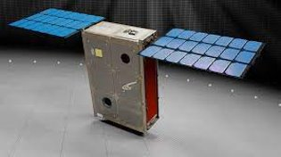
The challenge day
You and your team have been drafted into the UK Space Agency to work on a micro:sat project.
Recently there has been a Coronal Mass Ejection which has affected many satellites in orbit.
Your mission is to design and develop a prototype micro-satellite to meet several objectives including re-establishing communication with a damaged satellite.

Slide 3


Global Goal – 9.7
Build resilient infrastructure, promote inclusive and sustainable industrialization and foster innovation

Slide 4
The missions
Mission 1 Micro:sat telemetry Parachute Data capture and analysis | Mission 2 TOP SECRET Encryption
Mission 3 Space debris Robotics Engineering | Mission 4 Collision detection system Collaboration/communication Standards and protocols
Bonus missions:
Elevator pitch
Open source your code
TikTok/YouTube shorts
Website

Slide 5
The success criteria
Ensure design and build meet the criteria
Refer back to the criteria often
Use them to check whether you are finished
If you are not sure, ask!

Slide 6
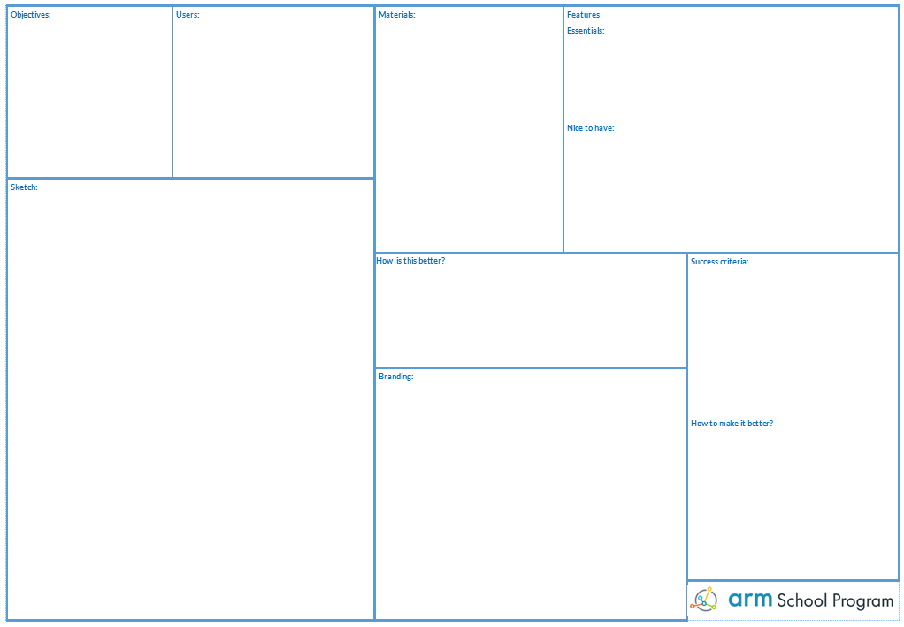
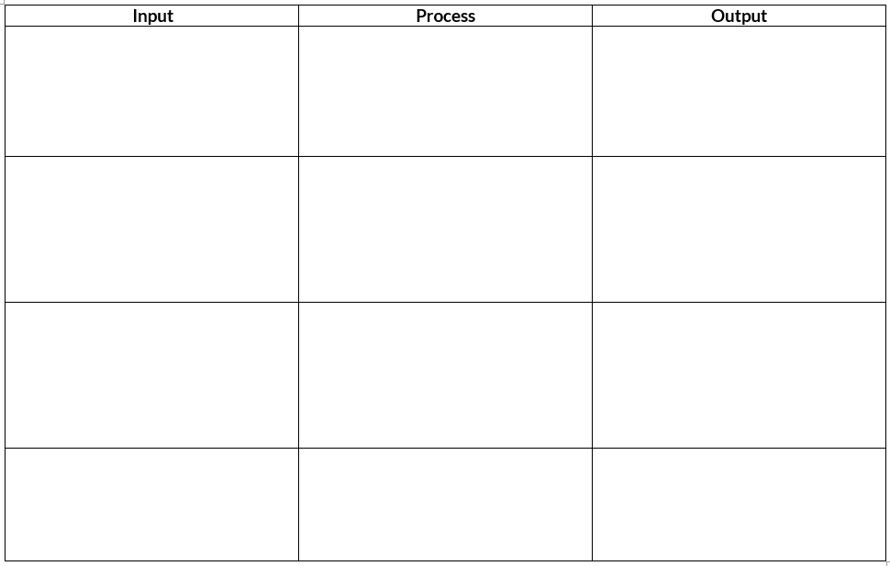
Design thinking
IPO tables
Concept designs and rapid prototyping
Iterating on designs

Slide 7
The Input Process Output (IPO) Model
All computer systems take data into a system using ‘Inputs’, carry out processes on the inputs and then display the result of that processing using ‘Outputs’
Using the Input, Process, Output worksheet try to identify what the outputs will be
Input
Process
Output

Slide 8
3,2,1
Lift off!

